Slide 1
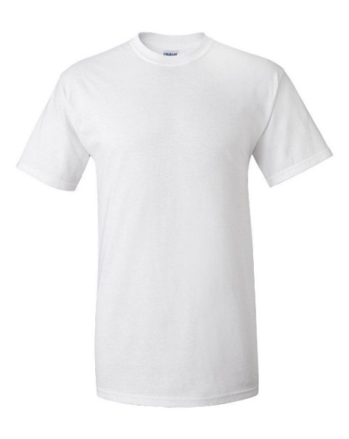
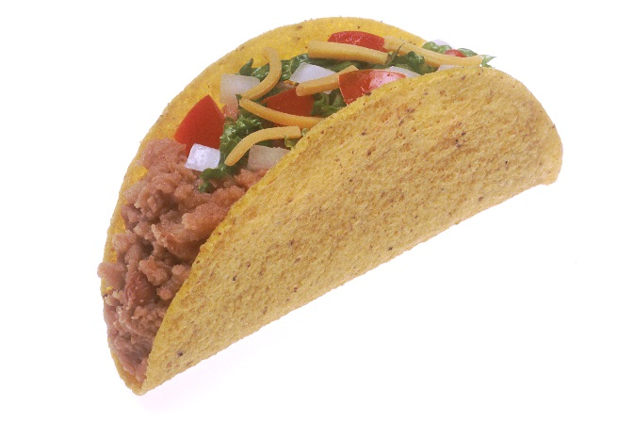
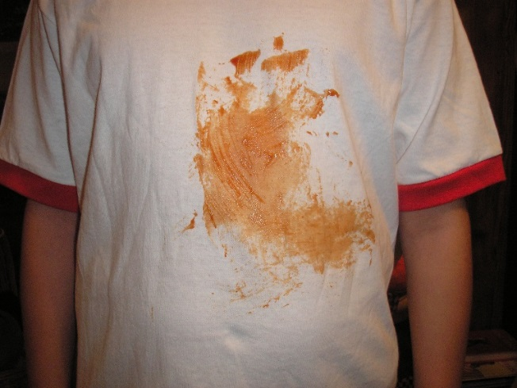
Tᕼᕮ ᔕᕼIᖇT ᔕᗩᐯᕮᖇ 1000
The shirt saver 1000 is a bib for all ages. To clean the shirt saver 1000, all you have to do is toss it in the washer. You can also adjust the length of the ribbon, for a better fit.
The shirt that saves the day!!!
That’s a nice shirt. ☺
Oh no! ☹
That taco looks good. ☺
before
After

